Slide 1
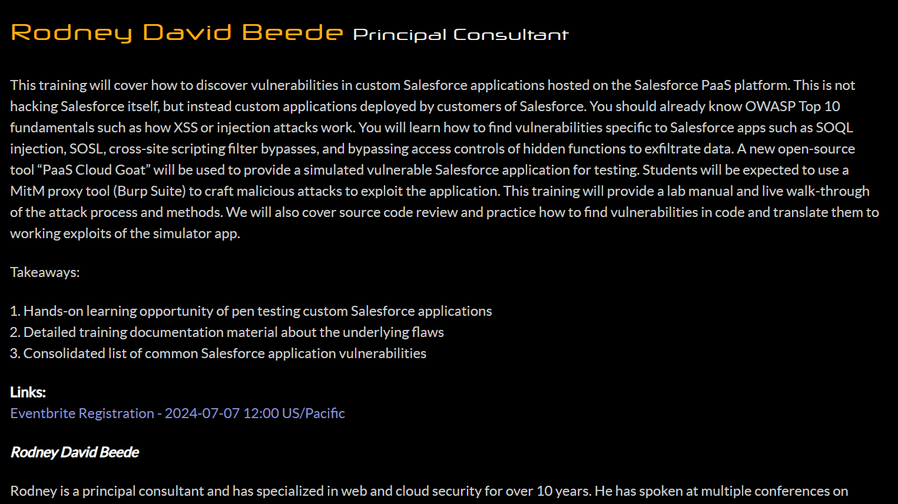
https://defcon.org/html/defcon-32/dc-32-workshops.html#54228
Notes:
https://defcon.org/html/defcon-32/dc-32-workshops.html#54228

Slide 2
Prerequisites
Practical experience with OWASP Top 10
Injection, XSS, IDOR
Salesforce CLI
https://developer.salesforce.com/tools/salesforcecli
Burp Suite (community or pro)
https://portswigger.net/burp/releases
PaaS Cloud Goat
https://github.com/Coalfire-Research/paas-cloud-goat

Slide 3
What is a Custom Salesforce App?
Salesforce.com
“Salesforce is cloud-based CRM software” (salesforce.com)
“Build Your Own Salesforce App” (salesforce.com)
Classic apps
Tabs, objects, feeds
Lightning apps
Look and feel customization
Languages
Apex (Java-like)
Visualforce
JavaScript

Slide 4
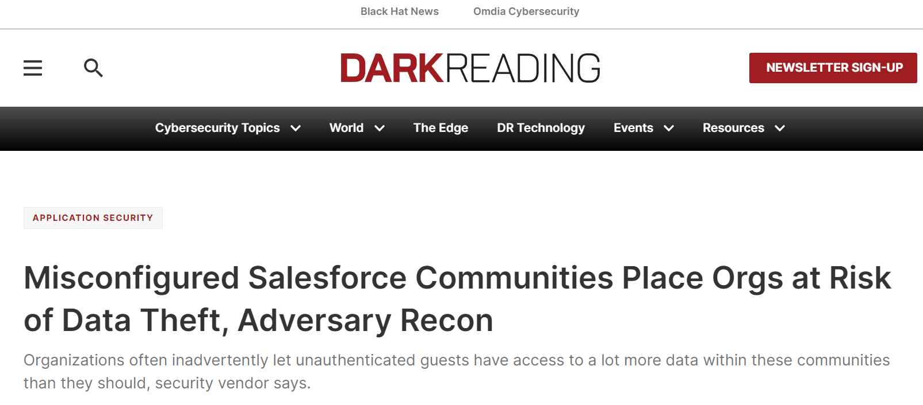
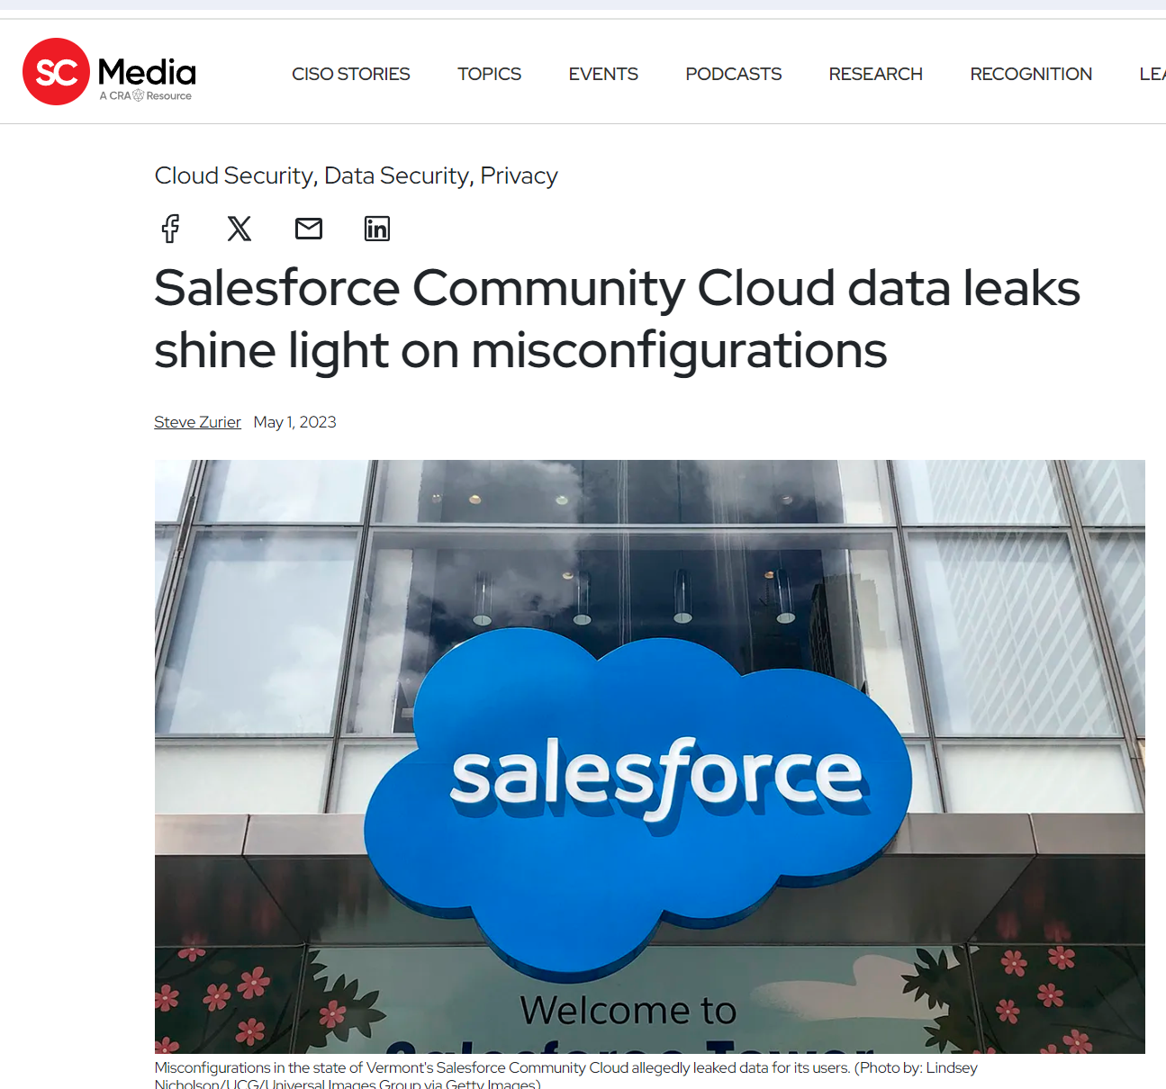
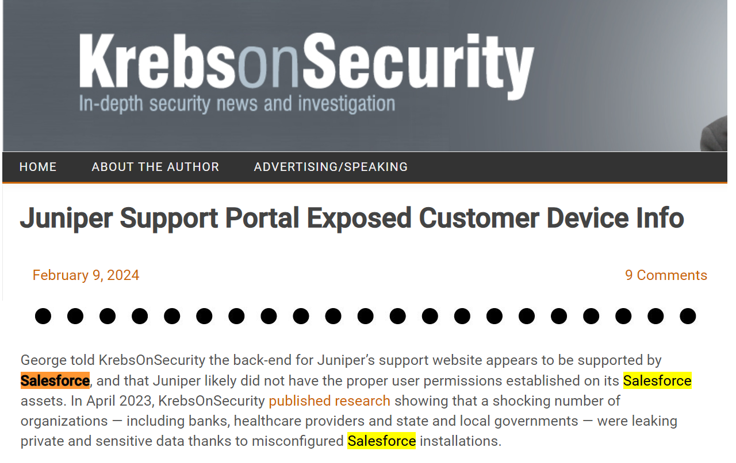
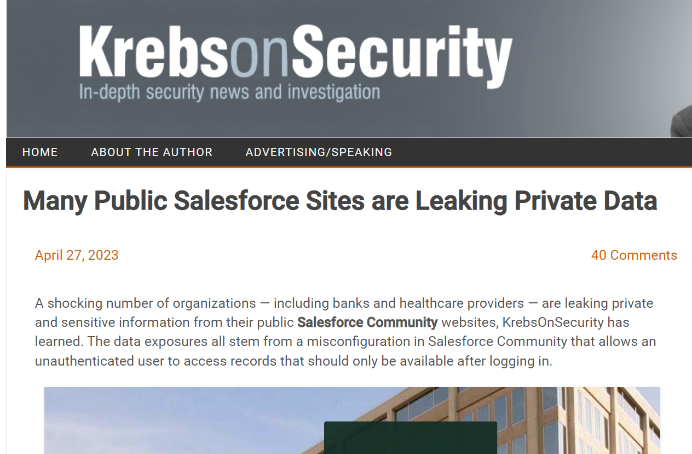
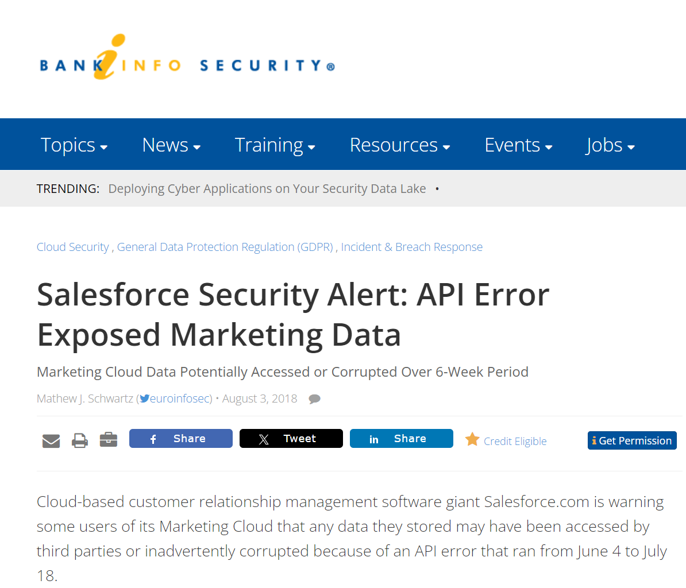
Why Test Custom Salesforce Apps?
https://krebsonsecurity.com/2024/02/juniper-support-portal-exposed-customer-device-info/
https://www.scmagazine.com/news/salesforce-community-cloud-data-leaks-misconfigurations
https://krebsonsecurity.com/2023/04/many-public-salesforce-sites-are-leaking-private-data/
https://www.bankinfosecurity.com/salesforce-security-alert-api-error-exposed-marketing-data-a-11278
https://www.darkreading.com/application-security/misconfigured-salesforce-communities-place-orgs-at-risk-of-data-theft-adversary-recon

Slide 5
What Not to Test
Know the Salesforce policy -https://www.salesforce.com/company/disclosure/
Spam, Brute Force, Denial of Service
Accessing other customers' data
Attacking Salesforce employees (social engr, etc.)
Tests against prod accounts
See salesforce.com Vulnerability Reporting Policy

Slide 6
Prior Work
Salesforce’s own developer security documentation
https://developer.salesforce.com/docs/atlas.en-us.apexcode.meta/apexcode/pages_security_tips_intro.htm
Other vulnerable cloud applications / tools
CloudGoat
IAM-Vulnerable
CloudFoxable
AWSGoat
OWASPServerlessGoat
AzureGoat
XMGoat
GCPGoat
http://flaws.cloud/
OpenStack care of Pen-Testing Cloud REST APIs
Notes:
Not all my own work but other work out there already

Slide 7
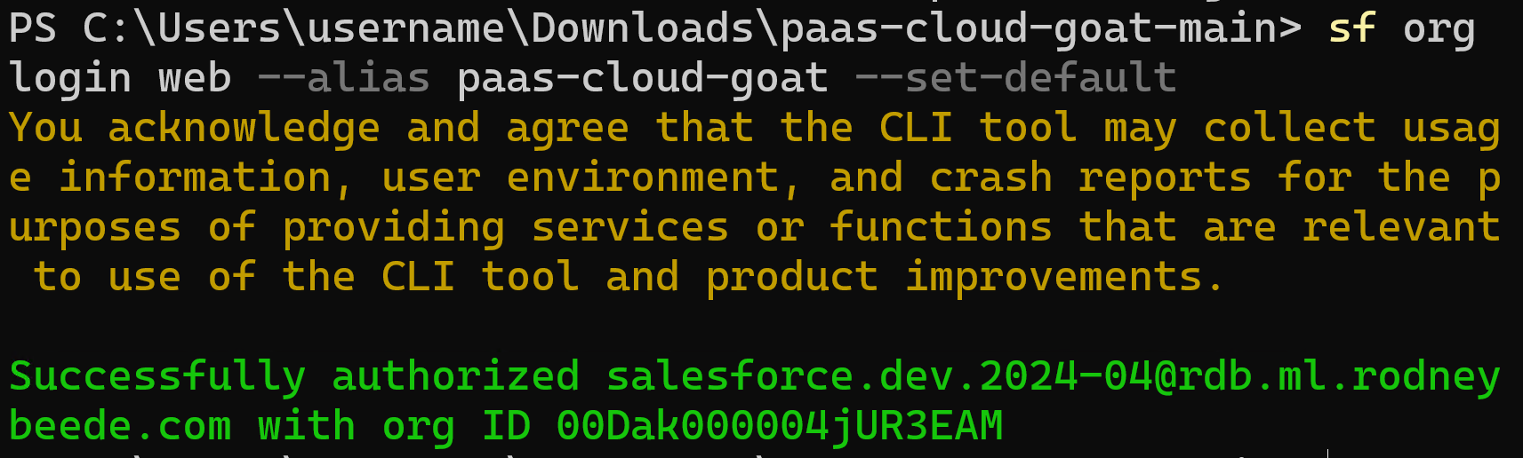
INSTALL.md
sf org login web --alias paas-cloud-goat --set-default

Slide 8
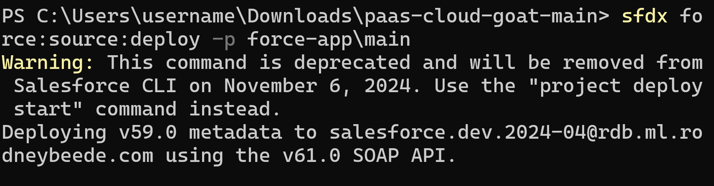
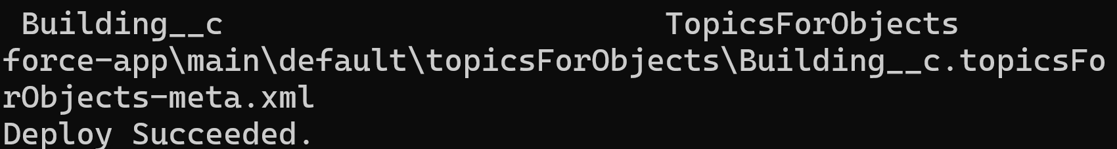
Deploy the App
sfdx force:source:deploy -p force-app\main

Slide 9
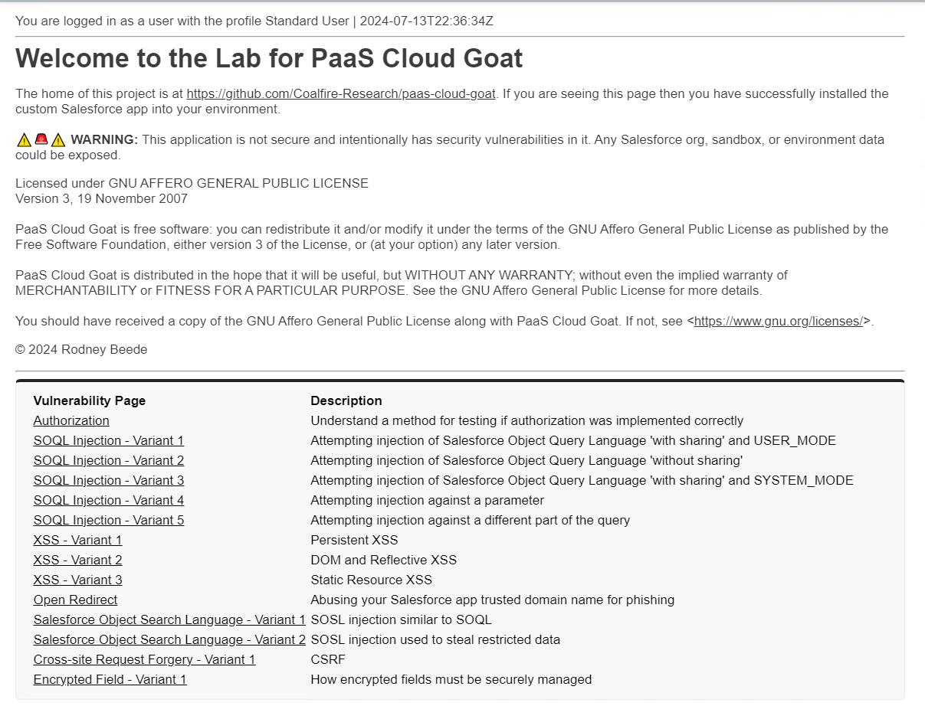

Slide 10
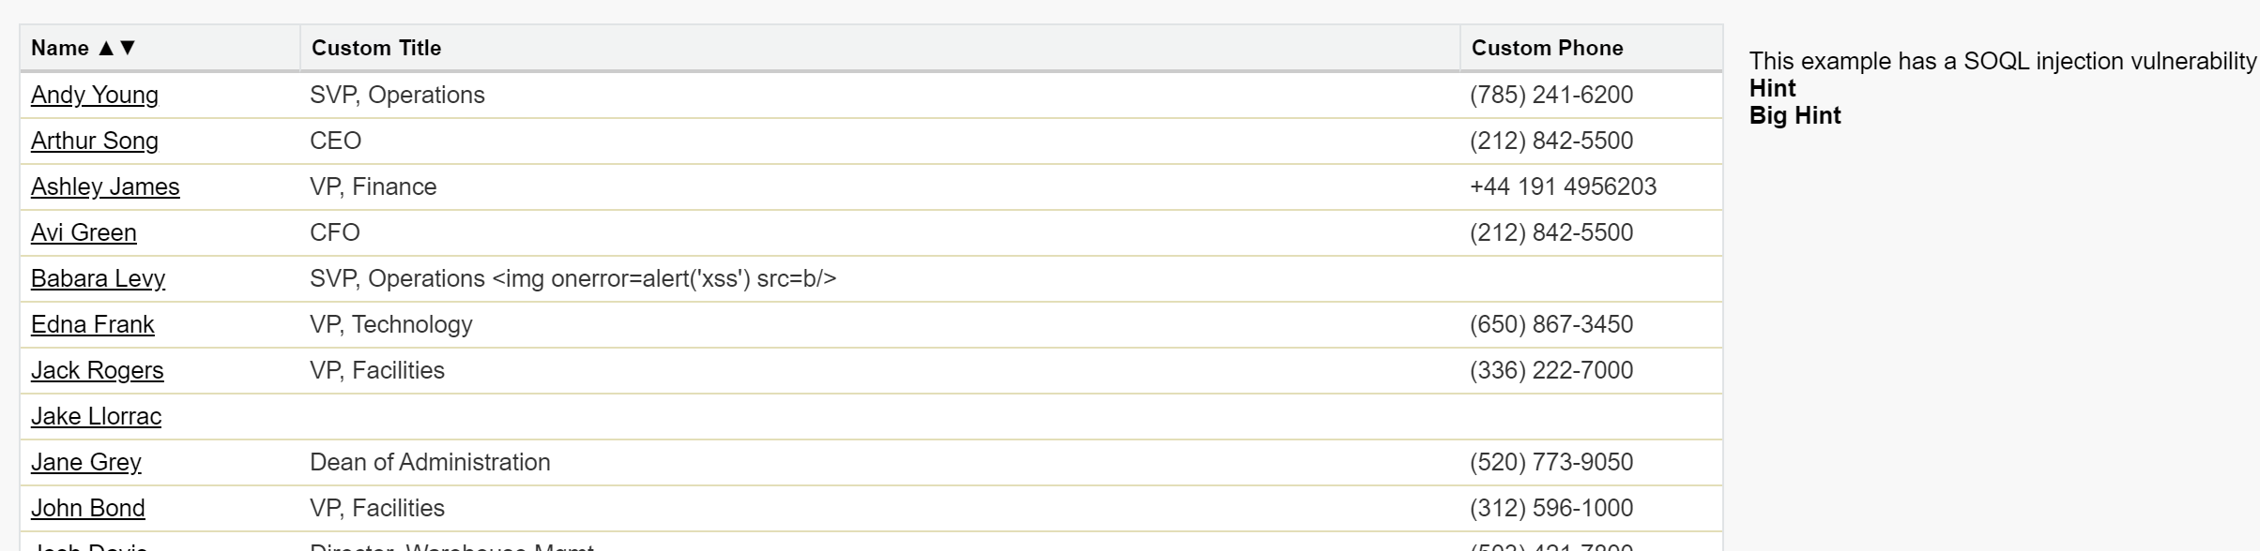
First Exploit – SOQL Injection
Notes:
Variant 4

Slide 11
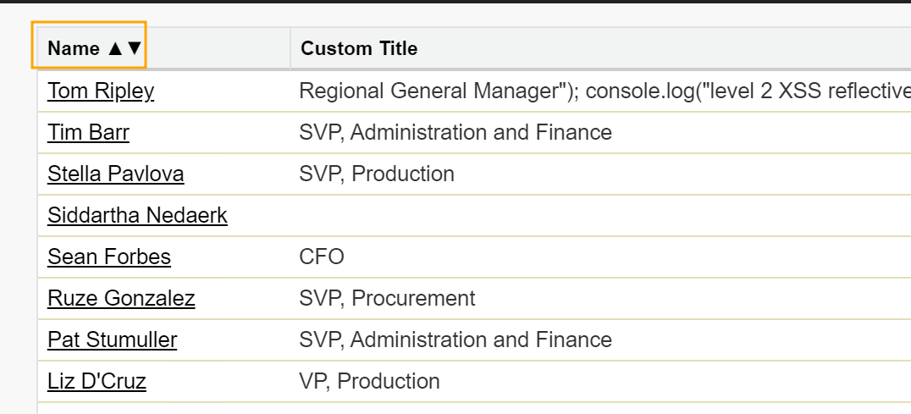

Slide 12
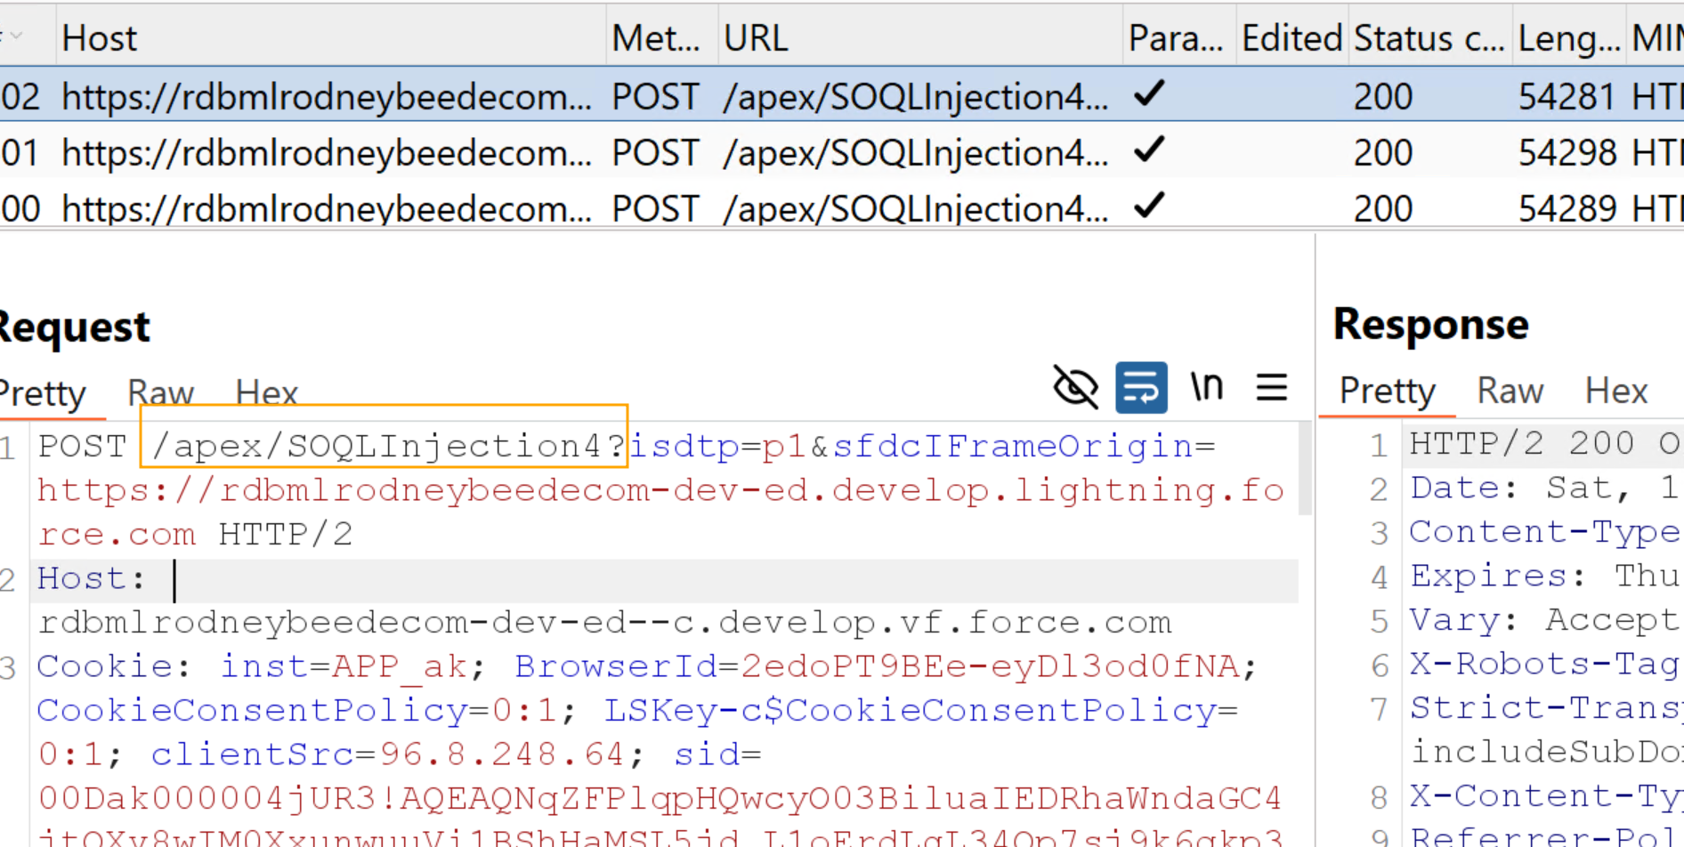

Slide 13
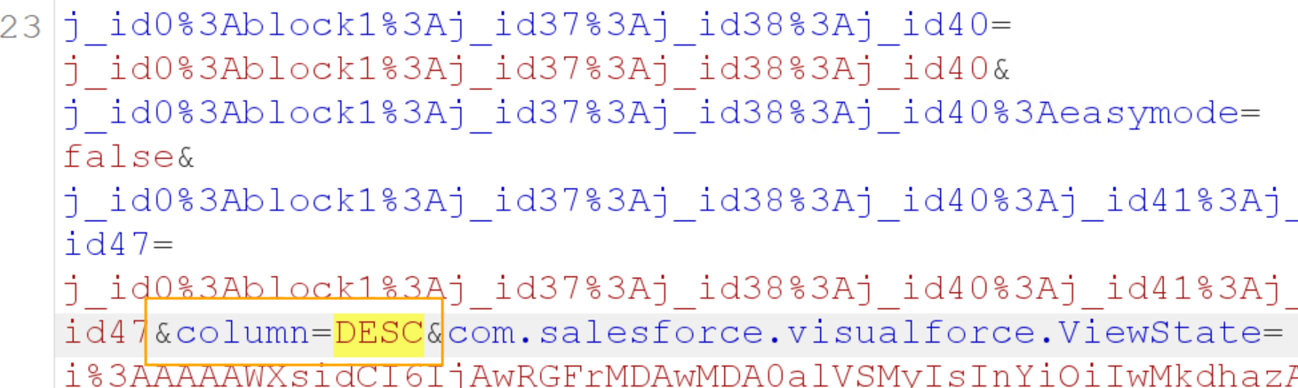

Slide 14
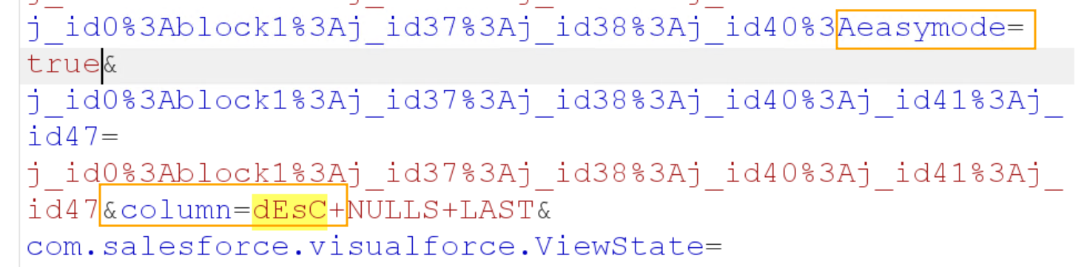

Slide 15
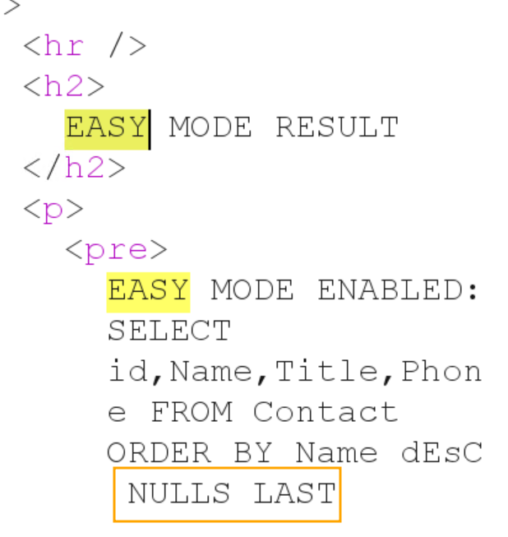

Slide 16
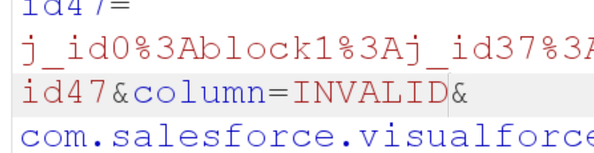
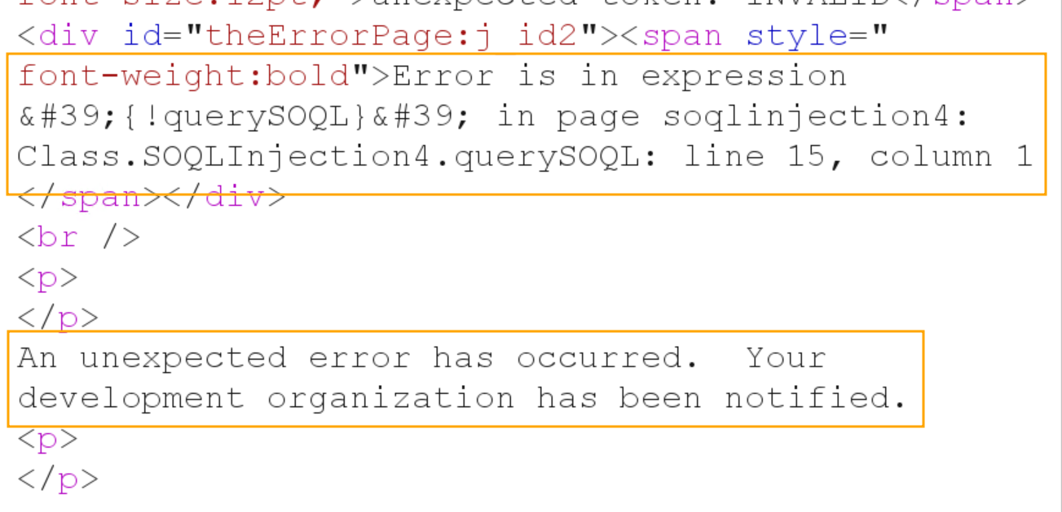

Slide 18
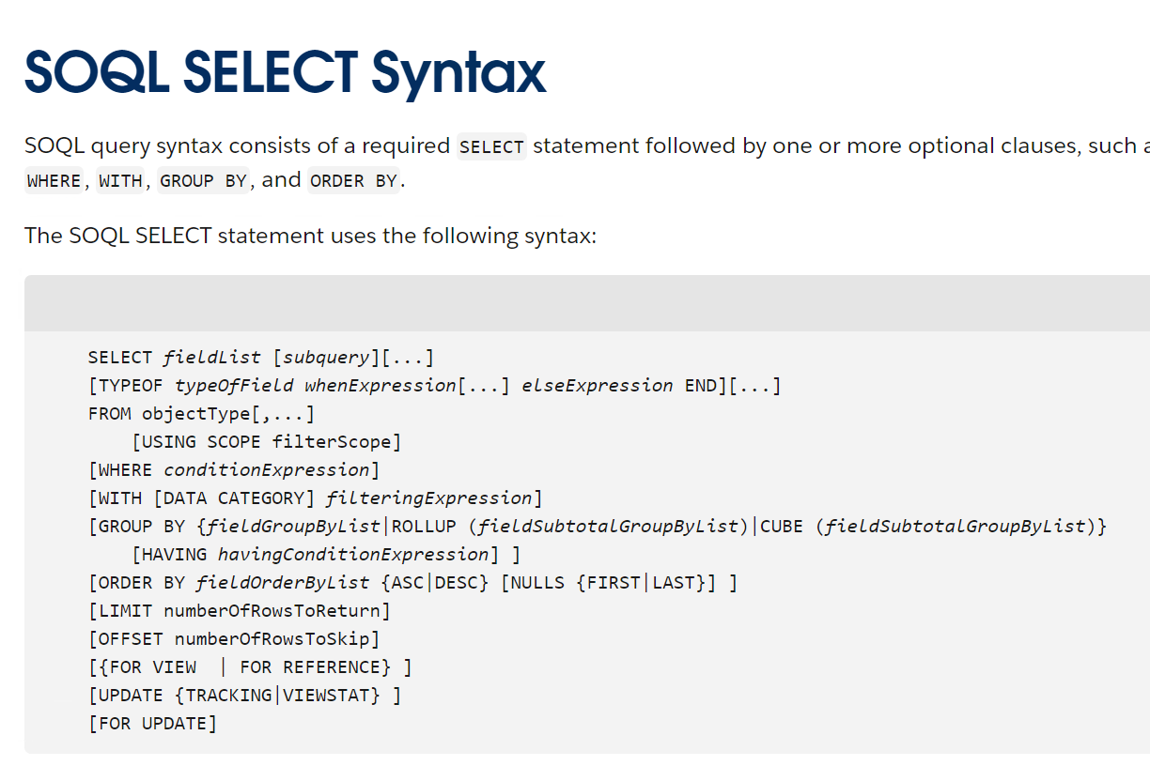
When injection is not exploitable
https://developer.salesforce.com/docs/atlas.en-us.soql_sosl.meta/soql_sosl/sforce_api_calls_soql_select.htm?isdtp=p1
Notes:
Variant 1
Understand SOQL syntax

Slide 19
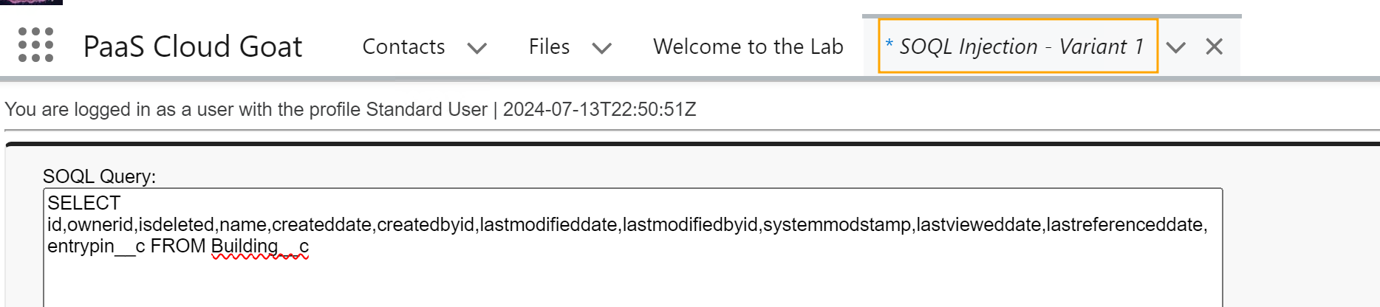
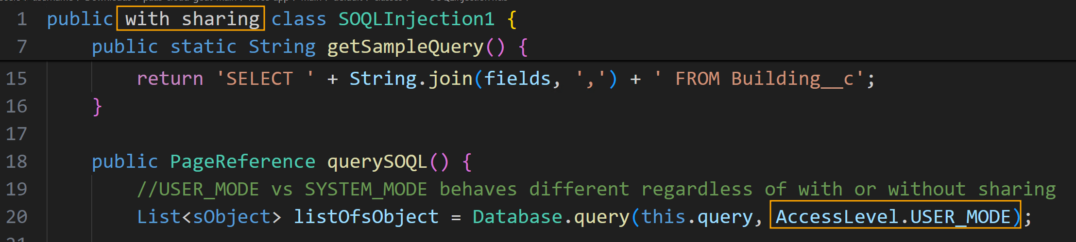
Notes:
Playground

Slide 20
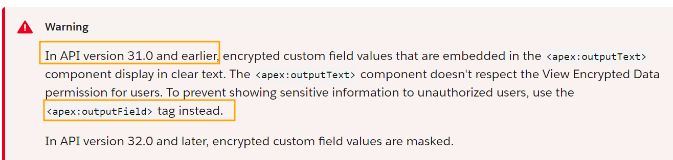
Hacking “encrypted” fields
https://developer.salesforce.com/docs/atlas.en-us.pages.meta/pages/pages_compref_outputText.htm

Slide 21
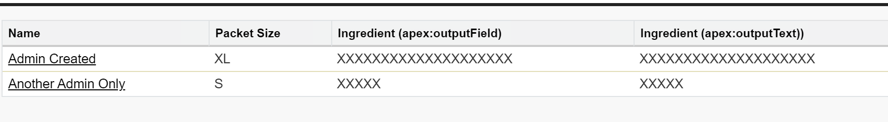
Notes:
Field was masked due to later API version. Had it been the older API version encrypted data would have been revealed.

Slide 22
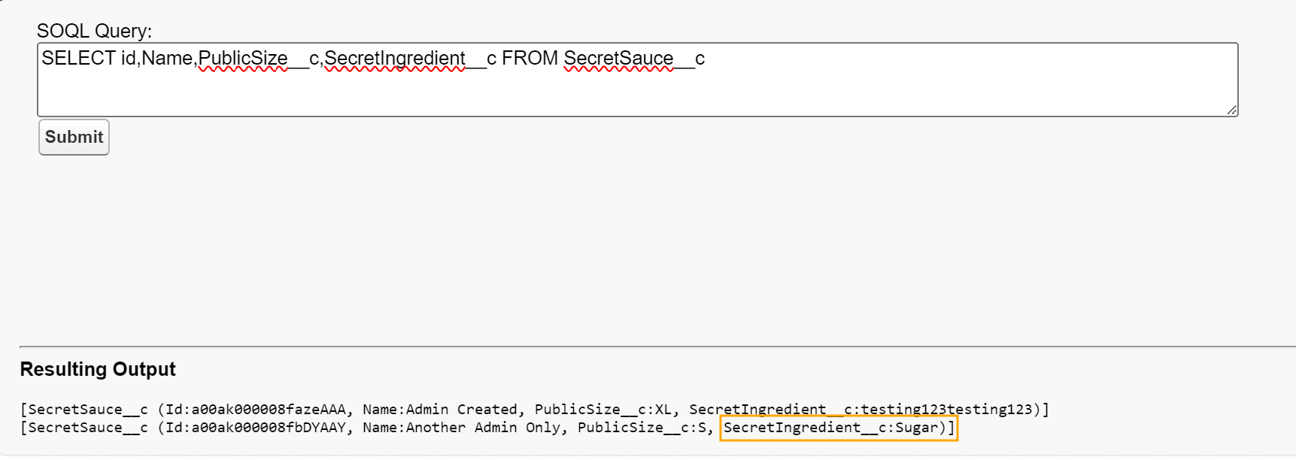

Slide 23
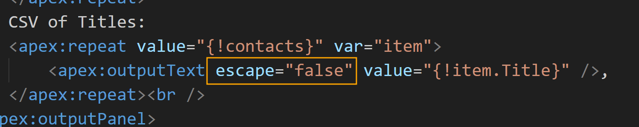
Code Review - XSS
Search for string “apex:outputText” (case insensitive)

Slide 24
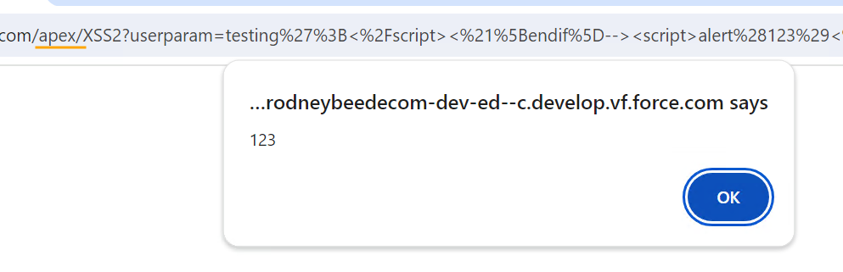
XSS - Reflective

Slide 25
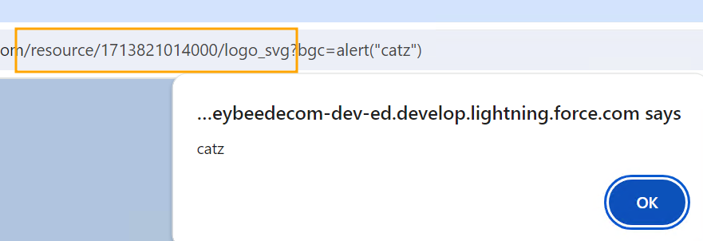
Third-party Library Vulnerability
Notes:
3rd party library vulnerable

Slide 26
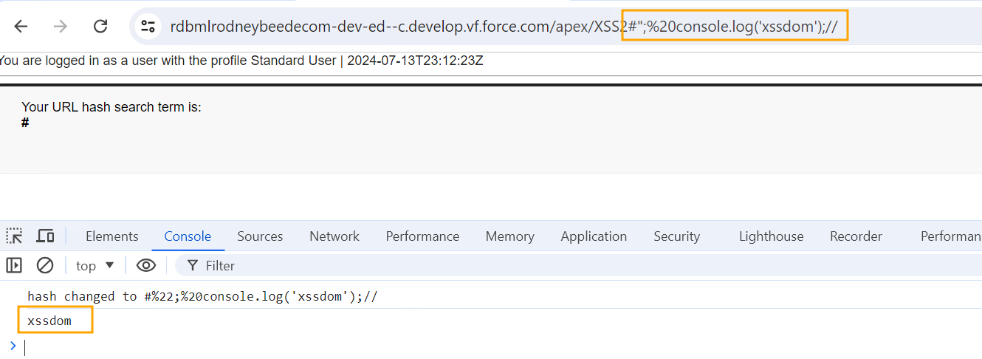
XSS - DOM

Slide 27
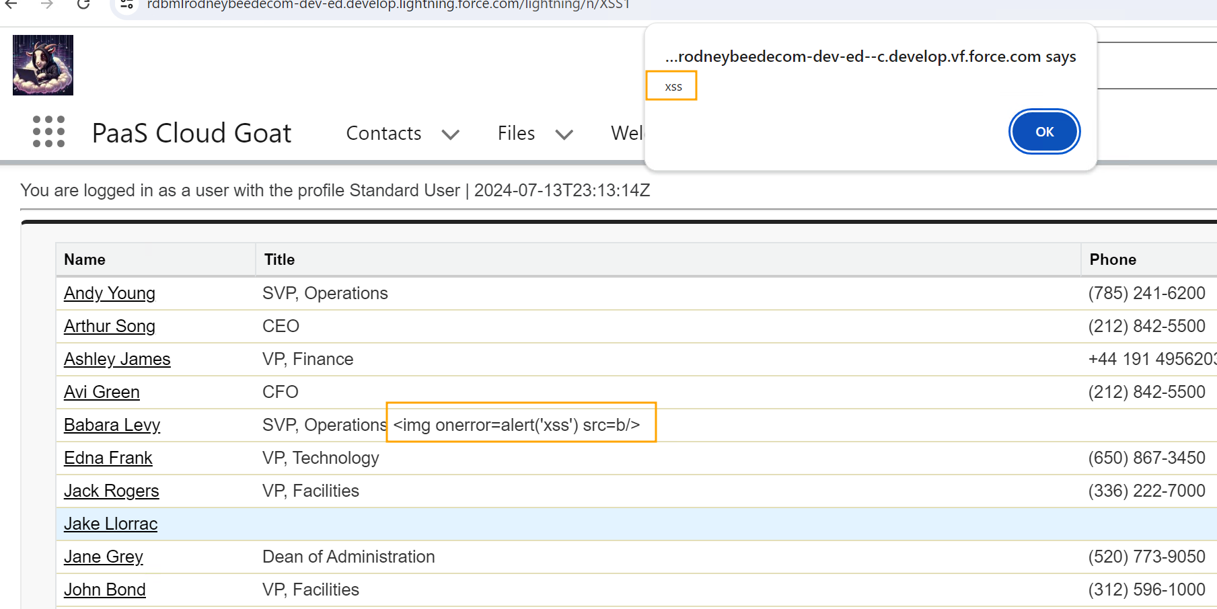
XSS - Persistent

Slide 28
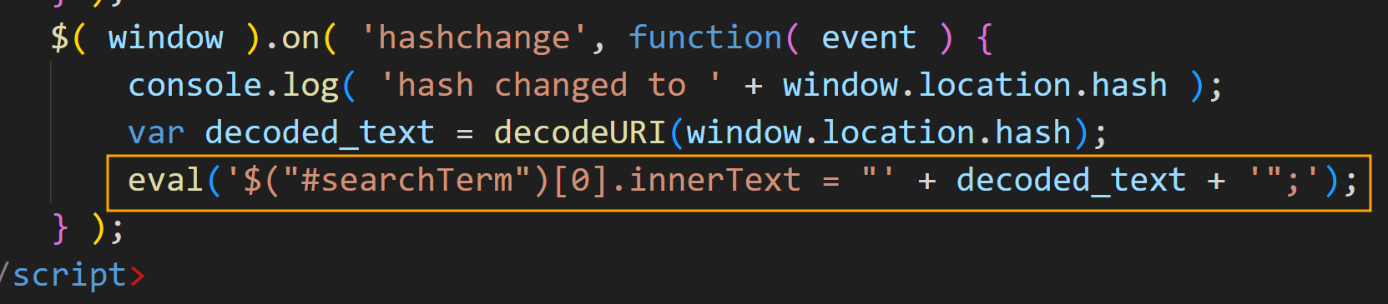

Slide 29
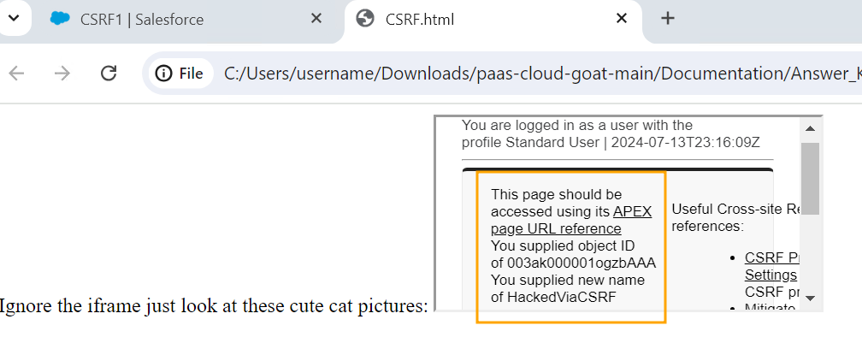
Cross-site Request Forgery (CSRF)

Slide 30
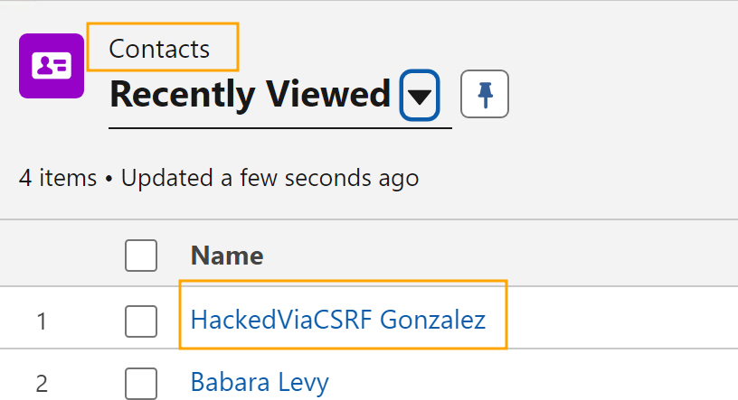

Slide 31
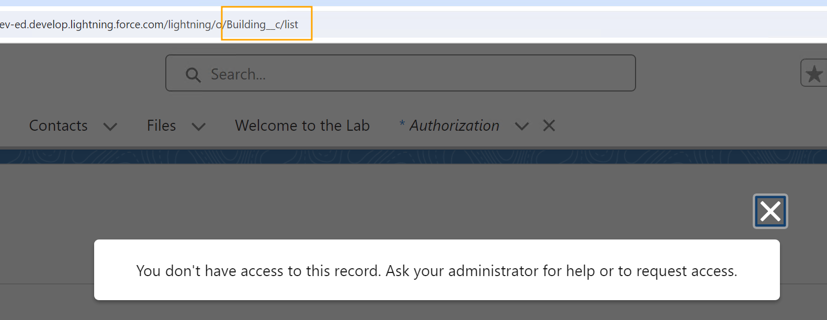
Testing Authorization
Notes:
CRUD/FLS (“System Context”)
Buildings example – authZ worked.

Slide 32
Forms of URLs:
Lightning Tab = /lightning/o/CustomObject__c
Lightning Tab = /lightning/o/Contacts (built-in)
Apex Page = /apex/GuessPageName
Salesforce Classic Experience = /a0/l
List page
Easier to iterate through a0, a1, b1, aa1, etc.

Slide 33
without sharing
grep –Ri ‘without sharing’
Default for Apex classes if not specified in code
Thus, your grep will not find all insecure Apex classes
“with sharing” enforces security context scope
So, ensure every Apex .cls uses “with sharing”

Slide 34
Conclusion
OWASP principals still apply to PaaS applications
Different technology designs (SOQL vs SQL) but still potential for vulnerabilities
PaaS Cloud Goat and lab manuals available via GitHub

